Slide 1
Smart Commute
Smart Traffic Management Multi-Agent System to Alleviate Urban Traffic Congestion

Slide 2
Problem Statement
Urban traffic congestion is a critical issue affecting cities worldwide. It leads to increased travel times, heightened pollution levels, and greater fuel consumption. Traditional traffic management systems, which often rely on static signals and rule-based decisions, fail to adapt dynamically to real-time conditions. This presentation explores a proposed multi-agent system leveraging artificial intelligence to enhance traffic management, providing a solution to these pressing challenges.

Slide 3
01
Addressed Problem Areas

Slide 4
Urban traffic congestion effects
Traffic congestion in urban areas results in significant delays that frustrate commuters and impact productivity. It contributes to higher levels of air pollution, which poses health risks to individuals living in congested areas. Moreover, this situation leads to increased fuel consumption and operational costs for transportation companies, impacting the overall economy.

Slide 5
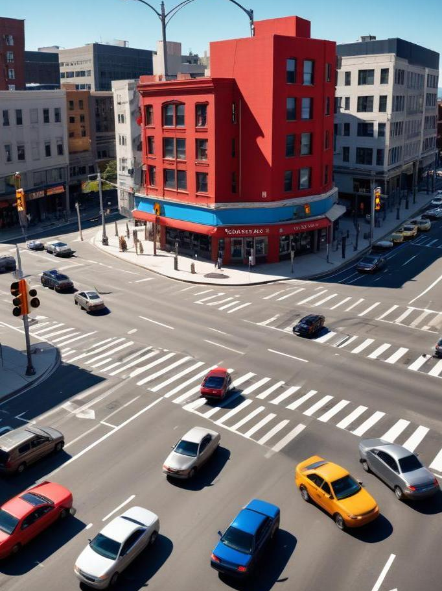
Limitations of static traffic signals
Static traffic signals are typically based on fixed time intervals and do not account for real-time traffic conditions. As a result, they can lead to inefficient traffic flow, where some routes remain congested while others are underutilized. These systems do not respond dynamically to changes such as accidents, road closures, or variations in vehicle volume, making them ineffective at managing contemporary traffic challenges.

Slide 6
Challenges of traditional systems
Traditional traffic management systems often rely on fixed algorithms and do not effectively adapt to real-time changes in traffic conditions. They struggle to incorporate various data sources, such as weather conditions, road closures, and accident information, leading to a lack of responsiveness. As a result, these systems can exacerbate traffic congestion rather than alleviate it.

Slide 7
02
Proposed Solution

Slide 8
Machine learning model function
SmartCommute is an AI-powered multi-agent system that leverages machine learning and real-time data to dynamically optimize commuting patterns — not just for individuals, but for teams, organizations, and entire city networks.
At the core of SmartCommute is a powerful ML model that ingests and analyzes a wide range of data sources:
📍 Traffic flow & congestion patterns
🌦️ Weather conditions
🚧 Road construction & closures
🚑 Accident & emergency data
🛣️ Toll pricing
👥 Carpooling options & availability
👤 Personal schedules, locations, and preferences
For teams or companies, SmartCommute finds the optimal overlap in commute times based on everyone's location and schedules — promoting carpooling, flexible work hours, lower congestion and better use of existing road networks.

Slide 9
02
Technical Architecture

Slide 10
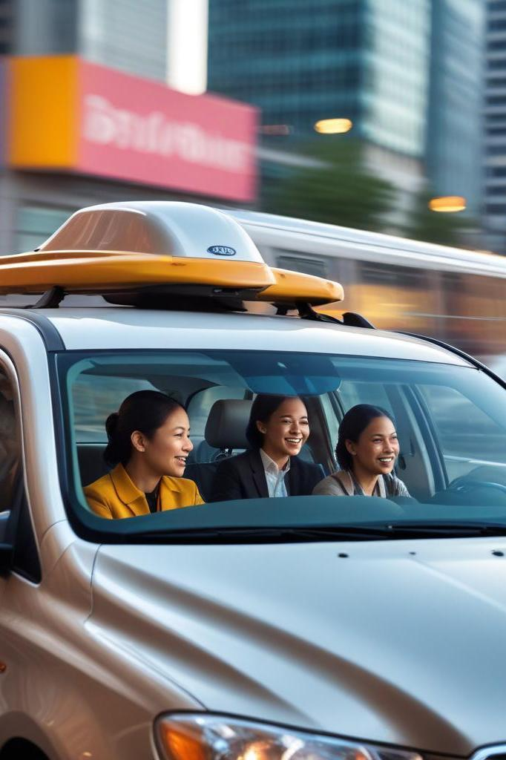
This app is a smart commute planner built using Flask, a lightweight web framework. When a team of users wants to find the best time to commute to work, they send in their preferences through a POST request to the /recommend-team-travel endpoint. The app then checks a time window (like 8–10 AM), breaks it into small time slots, and runs predictions for each one.
It uses machine learning models (loaded with joblib) to predict travel time and cost, based on real-time and historical data like weather, traffic congestion, tolls, and road closures. The model also considers personal details like where each team member lives. The system prepares this data using Pandas and feeds it into the models.
For every possible time slot, the app simulates or predicts conditions (like weather or accidents), estimates how long and how expensive the trip would be for each person, and calculates a total cost for the team. It chooses the time slot with the lowest overall cost and best travel time.
In the end, it gives back the best recommended commute time for the entire team to leave, helping them avoid traffic, reduce costs, and even encourage carpooling. All of this is done automatically behind the scenes using a combination of data, AI models, and smart logic.

Slide 11
🔧 Technologies/Tools Summary
Web API: Flask
Machine Learning: Scikit-learn, joblib
Data Processing: Pandas, datetime
Model Inference: Pre-trained regression/classifiers
Optimization: Custom cost-based heuristic
Simulation/Defaults: Random (for fallback predictions)

Slide 12
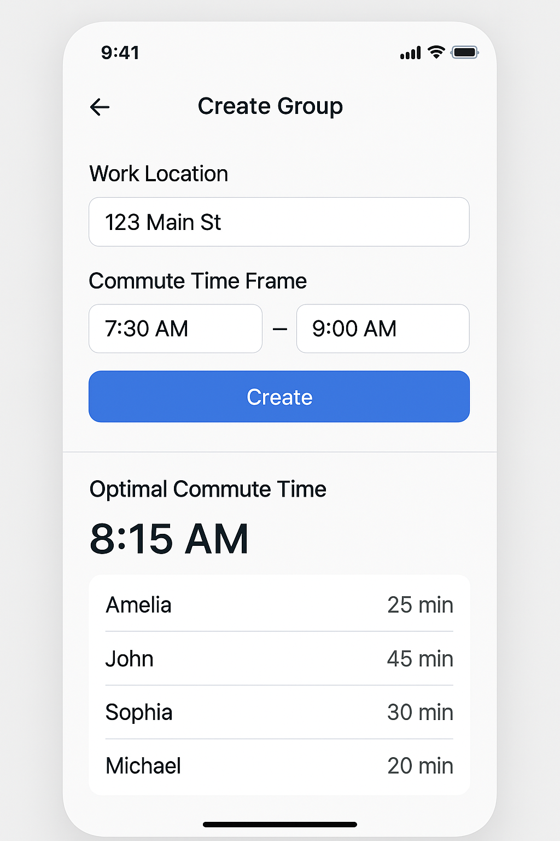
Demo, UI Mockup
This is an early-stage UI mockup showcasing the basic layout and functionality of our system. In this system, users can create groups for their teams and specify their work location and preferred commute time window. Based on this input, the system will analyze commute times and costs for each team member to determine the optimal commute time for the group.

Slide 13
Challenges
Future Enhancements
One challenge we faced was the lack of access to real training data. To overcome this, we created our own sample dataset tailored to the needs of the hackathon, which allowed us to effectively develop and test our system.
With additional time and resources, several future enhancements could significantly improve the system. These include integrating with real AI agents to access up-to-date traffic data, and partnering with platforms like Uber and Lyft to offer carpooling options for teams, reducing the reliance on personal vehicles. Additionally, collaborating with government agencies could help provide incentives for corporations to adopt the system, promoting flexible and non-traditional work start times to help alleviate traffic congestion.

Slide 14
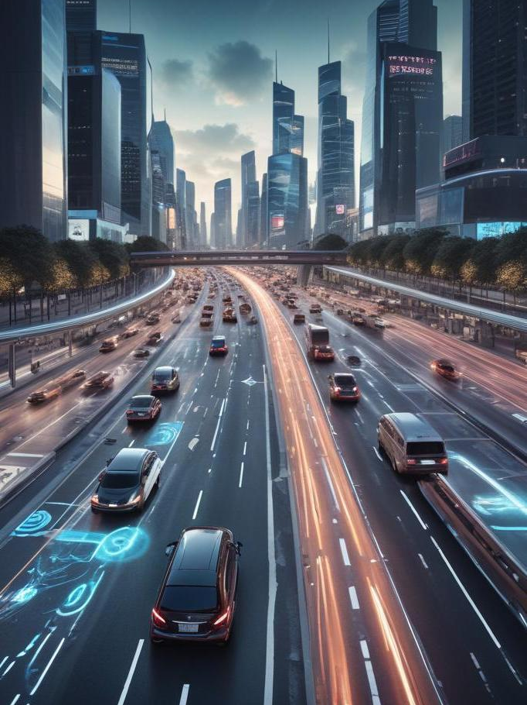
Conclusion
SmartCommute reimagines urban mobility by transforming static, outdated traffic systems into dynamic, intelligent decision-makers. By harnessing the power of machine learning, real-time data, and a collaborative multi-agent framework, it delivers smarter commute recommendations that adapt to real-world conditions — from weather and accidents to personal preferences and team schedules.
This system doesn't just reduce travel time and fuel consumption — it actively promotes sustainability, cost-efficiency, and a better quality of life for individuals and organizations alike. As cities continue to grow and mobility challenges intensify, SmartCommute offers a scalable, AI-driven solution that meets the moment and moves us all forward.

